Slide 1
Threads Management
Module 6
ITSC205
Operating Systems Internals

Slide 2
Threads
Thread: is a dynamic object (instance) that represents a control point in the process and executes a sequence of instructions.
An execution entity within a process
Thread is a mechanism that allows a program to do more than one thing at a time.
When you invoke a program, the operating system creates a new process and in that process creates a single thread, which runs the program sequentially.
That thread can create additional threads; all these threads run the same program in the same process, but each thread may be executing a different part of the program at any given time.

Slide 3
Threads Resources
Threads in the same process share:
same address space.
Process instructions
Most data
open files (descriptors)
signals and signal handlers
current working directory
User and group id
Each thread has a unique:
Thread ID
set of registers, stack pointer
stack for local variables, return addresses
signal mask
priority
Return value: errno

Slide 4
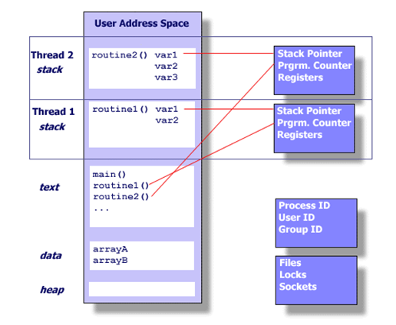
Threads

Slide 5
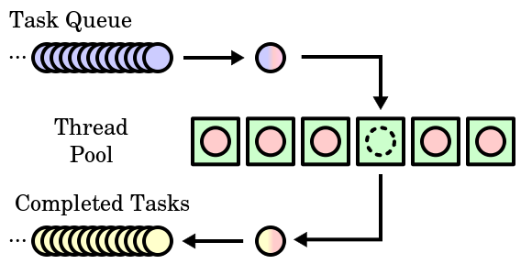
Thread Pool
https://en.wikipedia.org/wiki/Scheduling_(computing)#/media/File:Thread_pool.svg

Slide 6
Thread Operations
Thread operations include:
Thread creation,
Thread termination
Thread synchronization (joins, blocking)
Thread scheduling

Slide 7
Windows Processes and Threads
Access Token (Security )
Process
Object
VAD
VAD
VAD
Virtual Address Space Descriptors
Handle Table
object
object
Thread
Thread
Thread
. . .
Access Token
Notes:
In addition to a private address space and one or more threads, each process has a security identification and a list of open handles to objects such as files, shared memory sections, or one of the synchronization objects such as mutexes, events, or semaphores, as illustrated in this slide. Every process has a security context that is stored in an object called an access token. The process access token contains the security identification and credentials for the process. By default, threads don’t have their own access token, but they can obtain one, thus allowing individual threads to impersonate the security context of another process—including processes running on a remote Windows system—without affecting other threads in the process. (See Chapter 8 for more details on process and thread security.) The virtual address descriptors (VADs) are data structures that the memory manager uses to keep track of the virtual addresses the process is using. These data structures are described in more depth in the Memory Management unit (Book Chapter 7).

Slide 8
Windows Process Control Block (PCB)
Process ID (PID)
Windows implementation of PCB is split in multiple data structures
Parent PID
…
Next Process Block
PCB
List of open files
Handle Table
Image File Name
List of Thread Control Blocks
Thread Control Block (TCB)
Next TCB
…
Program Counter
Registers
…

Slide 9
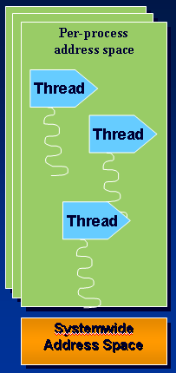
Windows Processes and Threads
Every process starts at least with one thread
Kernel creates initial thread with its stack and context
First thread executes the program’s “main” function
Can create other threads in the same process
Can create additional processes
Notes:
Although programs and processes appear similar on the surface, they are fundamentally different. A program is a static sequence of instructions, whereas a process is a container for a set of resources used when executing the instance of the program. At the highest level of abstraction, a Windows process comprises the following:
A private virtual address space, which is a set of virtual memory addresses that the process can use
An executable program, which defines initial code and data and is mapped into the process’s virtual address space
A list of open handles to various system resources, such as semaphores, communication ports, and files, that are accessible to all threads in the process
A security context called an access token that identifies the user, security groups, and privileges associated with the process
A unique identifier called a process ID (internally called a client ID)
At least one thread of execution

Slide 10
Windows Thread APIs
CreateThread
CreateRemoteThread
GetCurrentThreadId - returns global ID
GetCurrentThread - returns handle
SuspendThread/ResumeThread
ExitThread
TerminateThread - no DLL notification
GetExitCodeThread
GetThreadTimes
Notes:
The following are the thread-related functions (the description of the mechanism behind system calls is in Unit OS2):
AttachThreadInput Attaches the input processing mechanism of one thread to that of another thread.
CreateRemoteThread Creates a thread that runs in the virtual address space of another process.
CreateThread Creates a thread to execute within the virtual address space of the calling process.
ExitThread Ends a thread.
GetCurrentThread Retrieves a pseudo handle for the current thread.
GetCurrentThreadId Retrieves the thread identifier of the calling thread.
GetExitCodeThread Retrieves the termination status of the specified thread.
GetThreadId Retrieves the thread identifier of the specified thread.
GetThreadIOPendingFlag Determines whether a specified thread has any I/O requests pending.
GetThreadPriority Retrieves the priority value for the specified thread.
GetThreadPriorityBoost Retrieves the priority boost control state of the specified thread.
GetThreadTimes Retrieves timing information for the specified thread.
OpenThread Opens an existing thread object.
ResumeThread Decrements a thread's suspend count.
SetThreadAffinityMask Sets a processor affinity mask for the specified thread.
SetThreadIdealProcessor Specifies a preferred processor for a thread.
SetThreadPriority Sets the priority value for the specified thread.
SetThreadPriorityBoost Disables the ability of the system to temporarily boost the priority of a thread.
Sleep Suspends the execution of the current thread for a specified interval.
SleepEx Suspends the current thread until the specified condition is met.
SuspendThread Suspends the specified thread.
SwitchToThread Causes the calling thread to yield execution to another thread that is ready to run on the current processor.
TerminateThread Terminates a thread.
ThreadProc An application-defined function that serves as the starting address for a thread.
TlsAlloc Allocates a thread local storage (TLS) index.
TlsFree Releases a TLS index.
TlsGetValue Retrieves the value in the calling thread's TLS slot for a specified TLS index.
TlsSetValue Stores a value in the calling thread's TLS slot for a specified TLS index.
WaitForInputIdle Waits until the specified process is waiting for user input with no input pending, or until the time-out interval has elapsed.

Slide 11
POSIX-Threads
Each thread in a process is identified by a thread ID. It uses the type pthread_t.
#include <pthread.h>
Upon creation, each thread executes a thread function.
This is just an ordinary function
and contains the code that the thread should run.

Slide 12
pthread_create usage
int pthread_create (pthread_t * thread, const pthread_attr_t * attr, void * (*start_routine)(void *), void *arg);
pthread_create(&t1, NULL, print_msg, (void *) “hello”);

Slide 13
Thread Synchronization - Join threads
Linux schedules threads asynchronously, and your program must not rely on the relative order in which instructions are executed.
pthread_join function is a function similar to wait that waits for a thread to finish instead of a process.
pthread_join blocks the calling thread until the thread specified by thread terminates.
pthread_join returns 0 when the thread terminates.

Slide 14
pthread_join usage
int pthread_join( pthread_t thread, NULL)
pthread_join(t1, NULL)

Slide 15
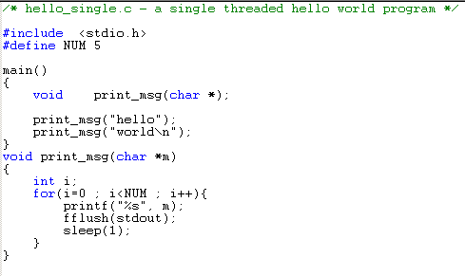
Single Thread program (process)

Slide 16
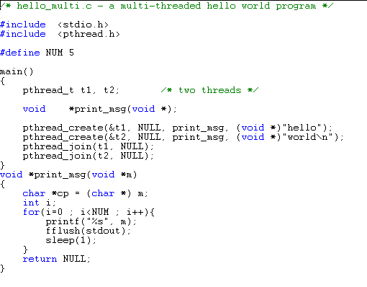
pthread_create

Slide 17
Windows tools to manage Process and Threads
Built-in tools in Windows
Task Manager, Performance Tool
Tasklist command
wmic process
Tools from www.sysinternals.com
Process Monitor – Displays open files, loaded DLLs, security info, etc.
Process Explorer
Pslist – list processes on local or remote systems
Listdlls - displays full path of EXE & DLLs loaded in each process
Notes:
A number of tools for viewing (and modifying) processes and process information are available. These tools are included within Windows itself and within the Windows Support Tools, Windows Debugging Tools, Windows resource kits, the Platform SDK, and from www.sysinternals.com. Many of these tools show overlapping subsets of the core process and thread information, sometimes identified by different names.

Slide 18
References
Silberschatz, Galvin and Gagne, Operating System Concepts with Java, John Wiley & Sons, latest edition.
Process Scheduling and Threads
Thread priorities
Thread Synchronization

